Slide 1

Branch - CSE Python Programming
Lecture – 13 Strings – Part 2
By
Dr. Smita Tiwari
Assistant Professor
Department of Computer Science and Engineering
School of Engineering & Technology

Slide 2
Built-in functions to work with Python
Various built-in functions that work with sequence, work with strings as well.
Some of the commonly used ones are enumerate() and len().
The enumerate() returns an enumerate object which contains the index and value of all the items in the string as pairs. This can be useful for iteration.
Similarly, len() returns the length (no. of characters) of the string.

Slide 3
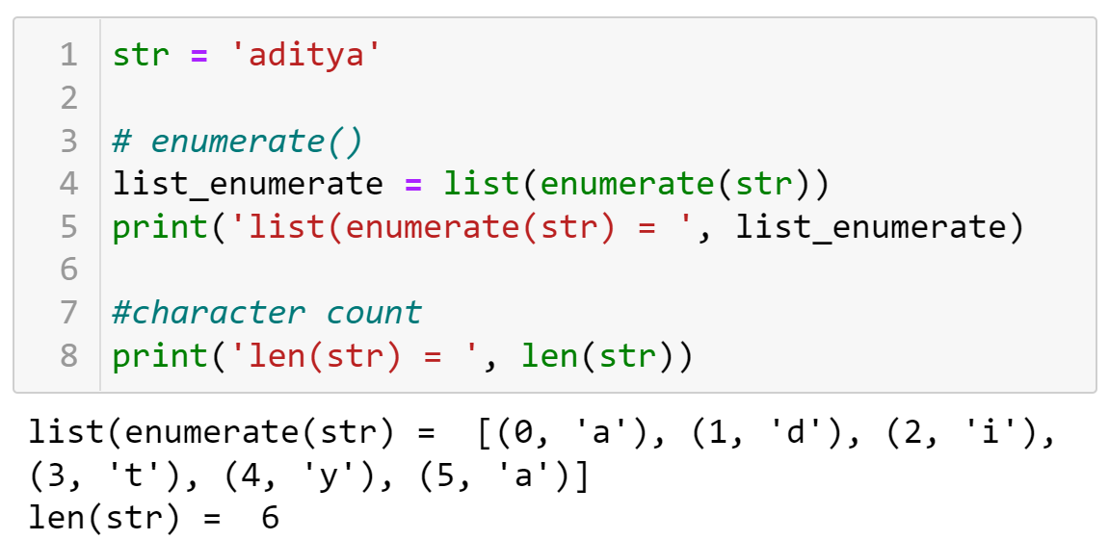
Built-in functions to work with Python

Slide 4
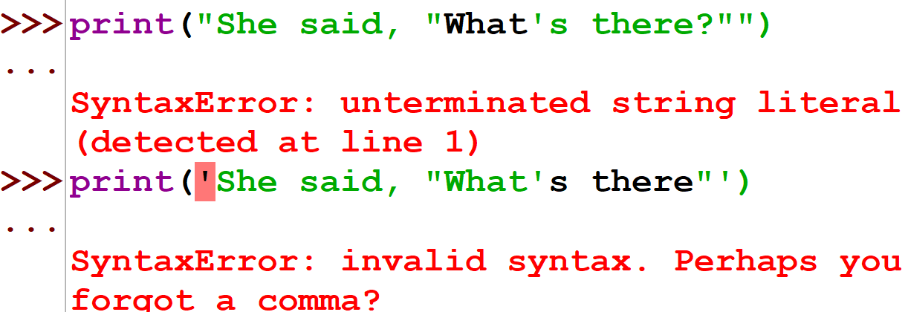
Python String Formatting
Escape Sequence
If we want to print a text like “She said, “What’s there?”, we can neither use single quotes nor double quotes.
This will result in a SyntaxError as the text itself contains both single and double quotes.

Slide 5
Python String Formatting
One way to solve this is to use triple quotes.
Alternatively, we can use escape sequences.
An escape sequence starts with a backslash (\) and is interpreted differently.
If we use a single quote to represent a string, all the single quotes inside the string must be escaped.
Similar is the case with double quotes. On the next slide, it is shown that how it can be done to represent the text which we saw in previous slide.

Slide 6
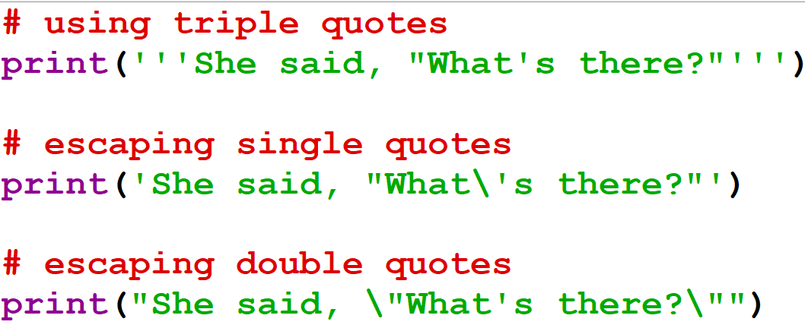
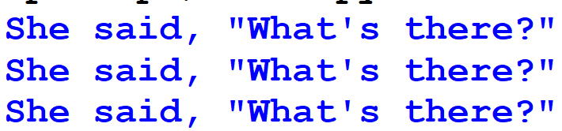
Python String Formatting

Slide 7
Python String Formatting
Escape Sequence | Description
\newline | Backslash and newline ignored
\\ | Backslash
\’ | Single quote
\” | Double quote
\a | ASCII Bell
\b | ASCII Backspace
\f | ASCII Formfeed
\n | ASCII Linefeed
\r | ASCII Carriage Return
\t | ASCII Horizontal Tab
\v | ASCII Vertical Tab
\ooo | Character with octal value ooo
\xHH | Character with hexadecimal value HH

Slide 8
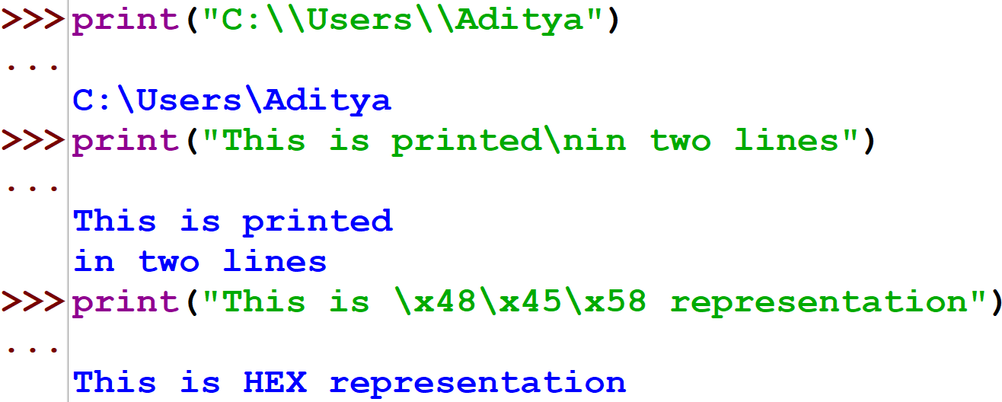
Python String Formatting

Slide 9
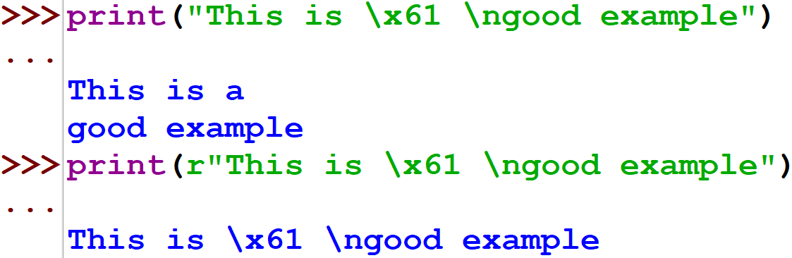
Raw String to ignore scape sequence
Sometimes we may wish to ignore the escape sequences inside a string. To do this, we can place r or R in front of the string. This will imply that it is a raw string and any escape sequence inside it will be ignored.

Slide 10
The format() Method for Formatting Strings
The format() method that is available with the string object is very versatile and powerful in formatting strings.
Format strings contain curly braces {} as placeholders or replacement fields which get replaced.
We can use positional arguments or keyword arguments to specify the order.
Example shown on the next slide.

Slide 11
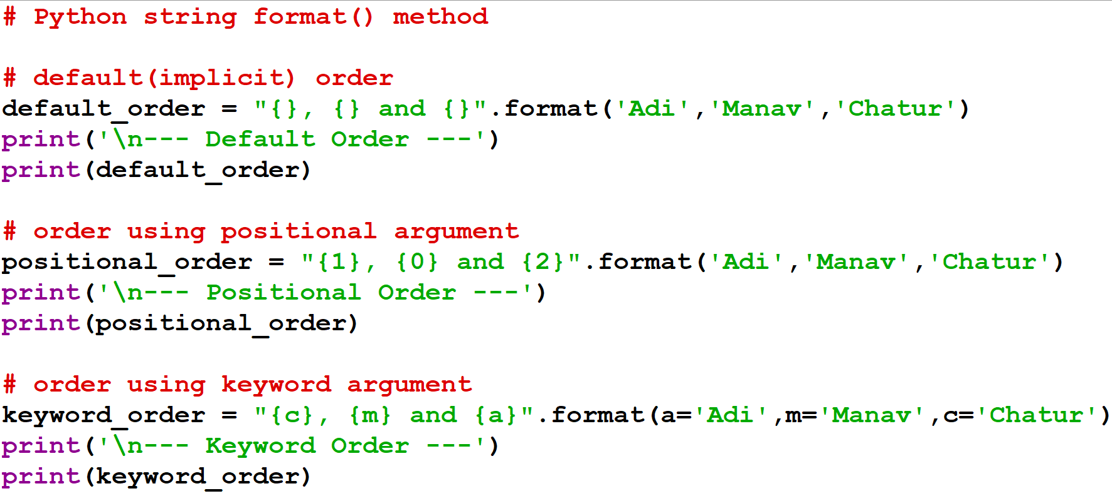
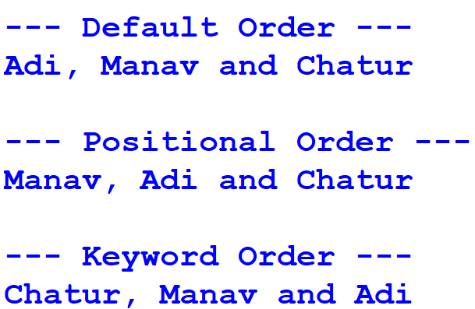
The format() Method for Formatting Strings

Slide 12
The format() Method for Formatting Strings
The format() method can have optional format specifications.
They are separated from the field name using colon.
For example, we can left-justify <, right-justify >, or center ^ a string in the given space.
We can also format integers as binary, hexadecimal, etc. and floats can be rounded or displayed in the exponent format.

Slide 13
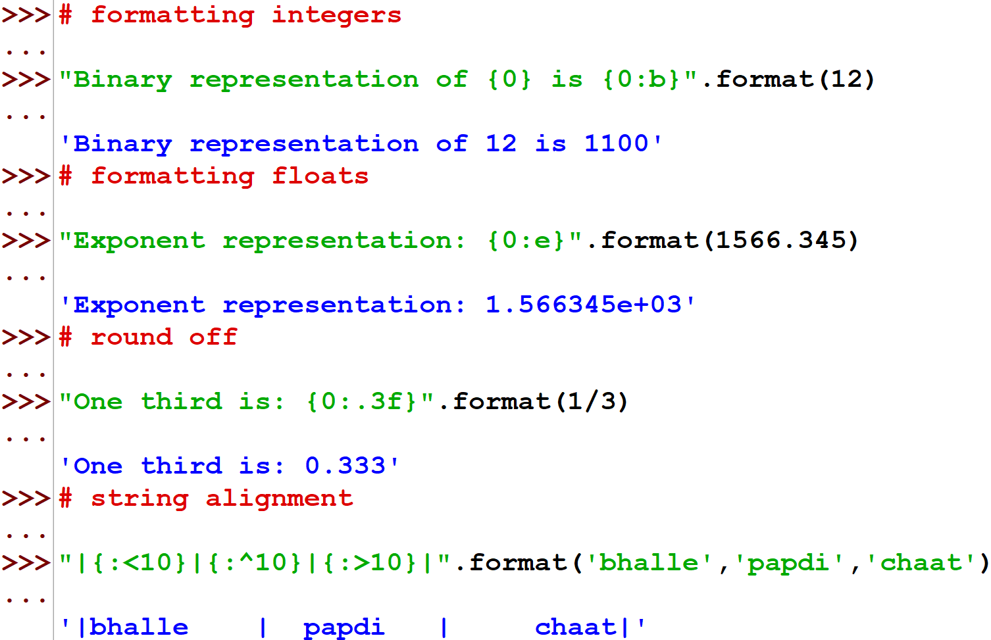
The format() Method for Formatting Strings

Slide 14
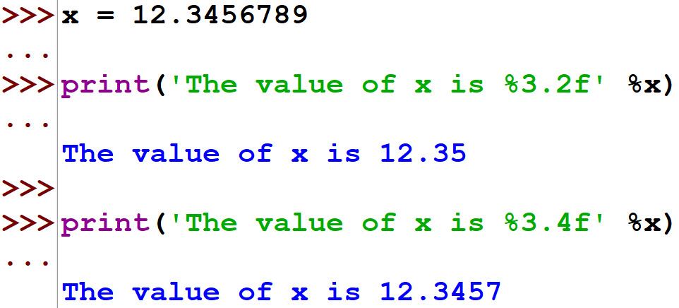
Old style formatting
We can even format strings like the old sprintf() style used in C programming language. We can use the % operator to accomplish this.

Slide 15
THANK YOU

